Slide 1
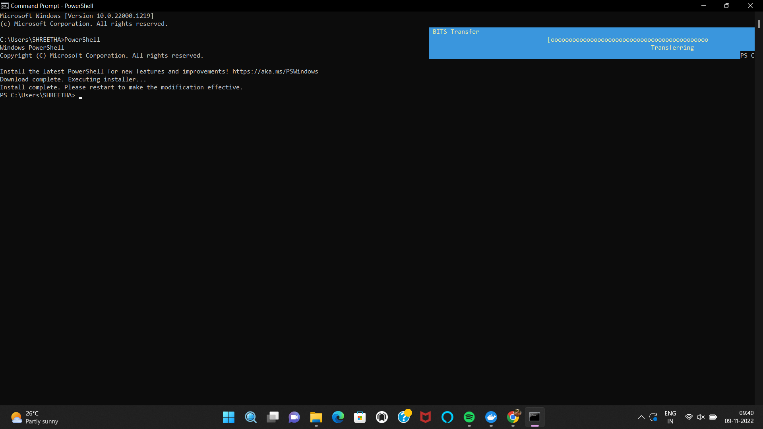
Environment Setup
IBM CLOUD CLI INSTALLATION
Team ID : PNT2022TMID07573

